Slide 1
SOMATIC SIMU
MUTATION SIGNATURE SIMULATOR FOR BENCHMARKING ALIGNMENT FREE MACHINE LEARNING CLASSIFICATION OF GENOMIC SIGNATURES
PROJECT UPDATE: JULY 22, 2020

Slide 2
Introduction
Mutation Signatures: overview
Somatic mutations in cancer genomes can have an exogenous and endogenous origin
Characteristic mutations lead to a signature
Signatures have unique identifying features that differ relative to other signatures
Figure 1. Catalogue of Mutations in Cancer Genomes
Source: https://software.broadinstitute.org/cancer/cga/msp

Slide 3
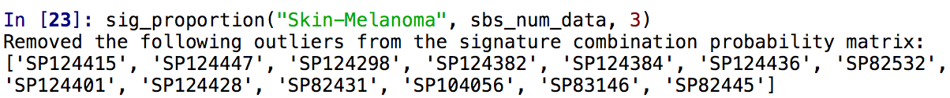
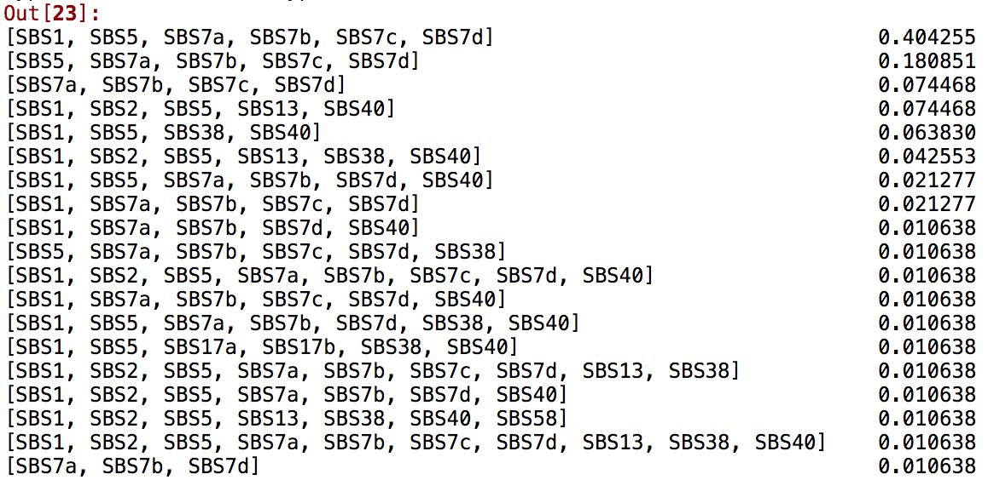
Introduction
Features of mutation signatures
Multiple mutational processes lead to superimposed signatures
Mathematical models estimate which mutations are attributed to which signature
Potential for classification
Figure 2: Set of single base substitution signatures and their relative proportion that contribute to Skin-Melanoma whole genome sequences in the PCAWG dataset

Slide 4
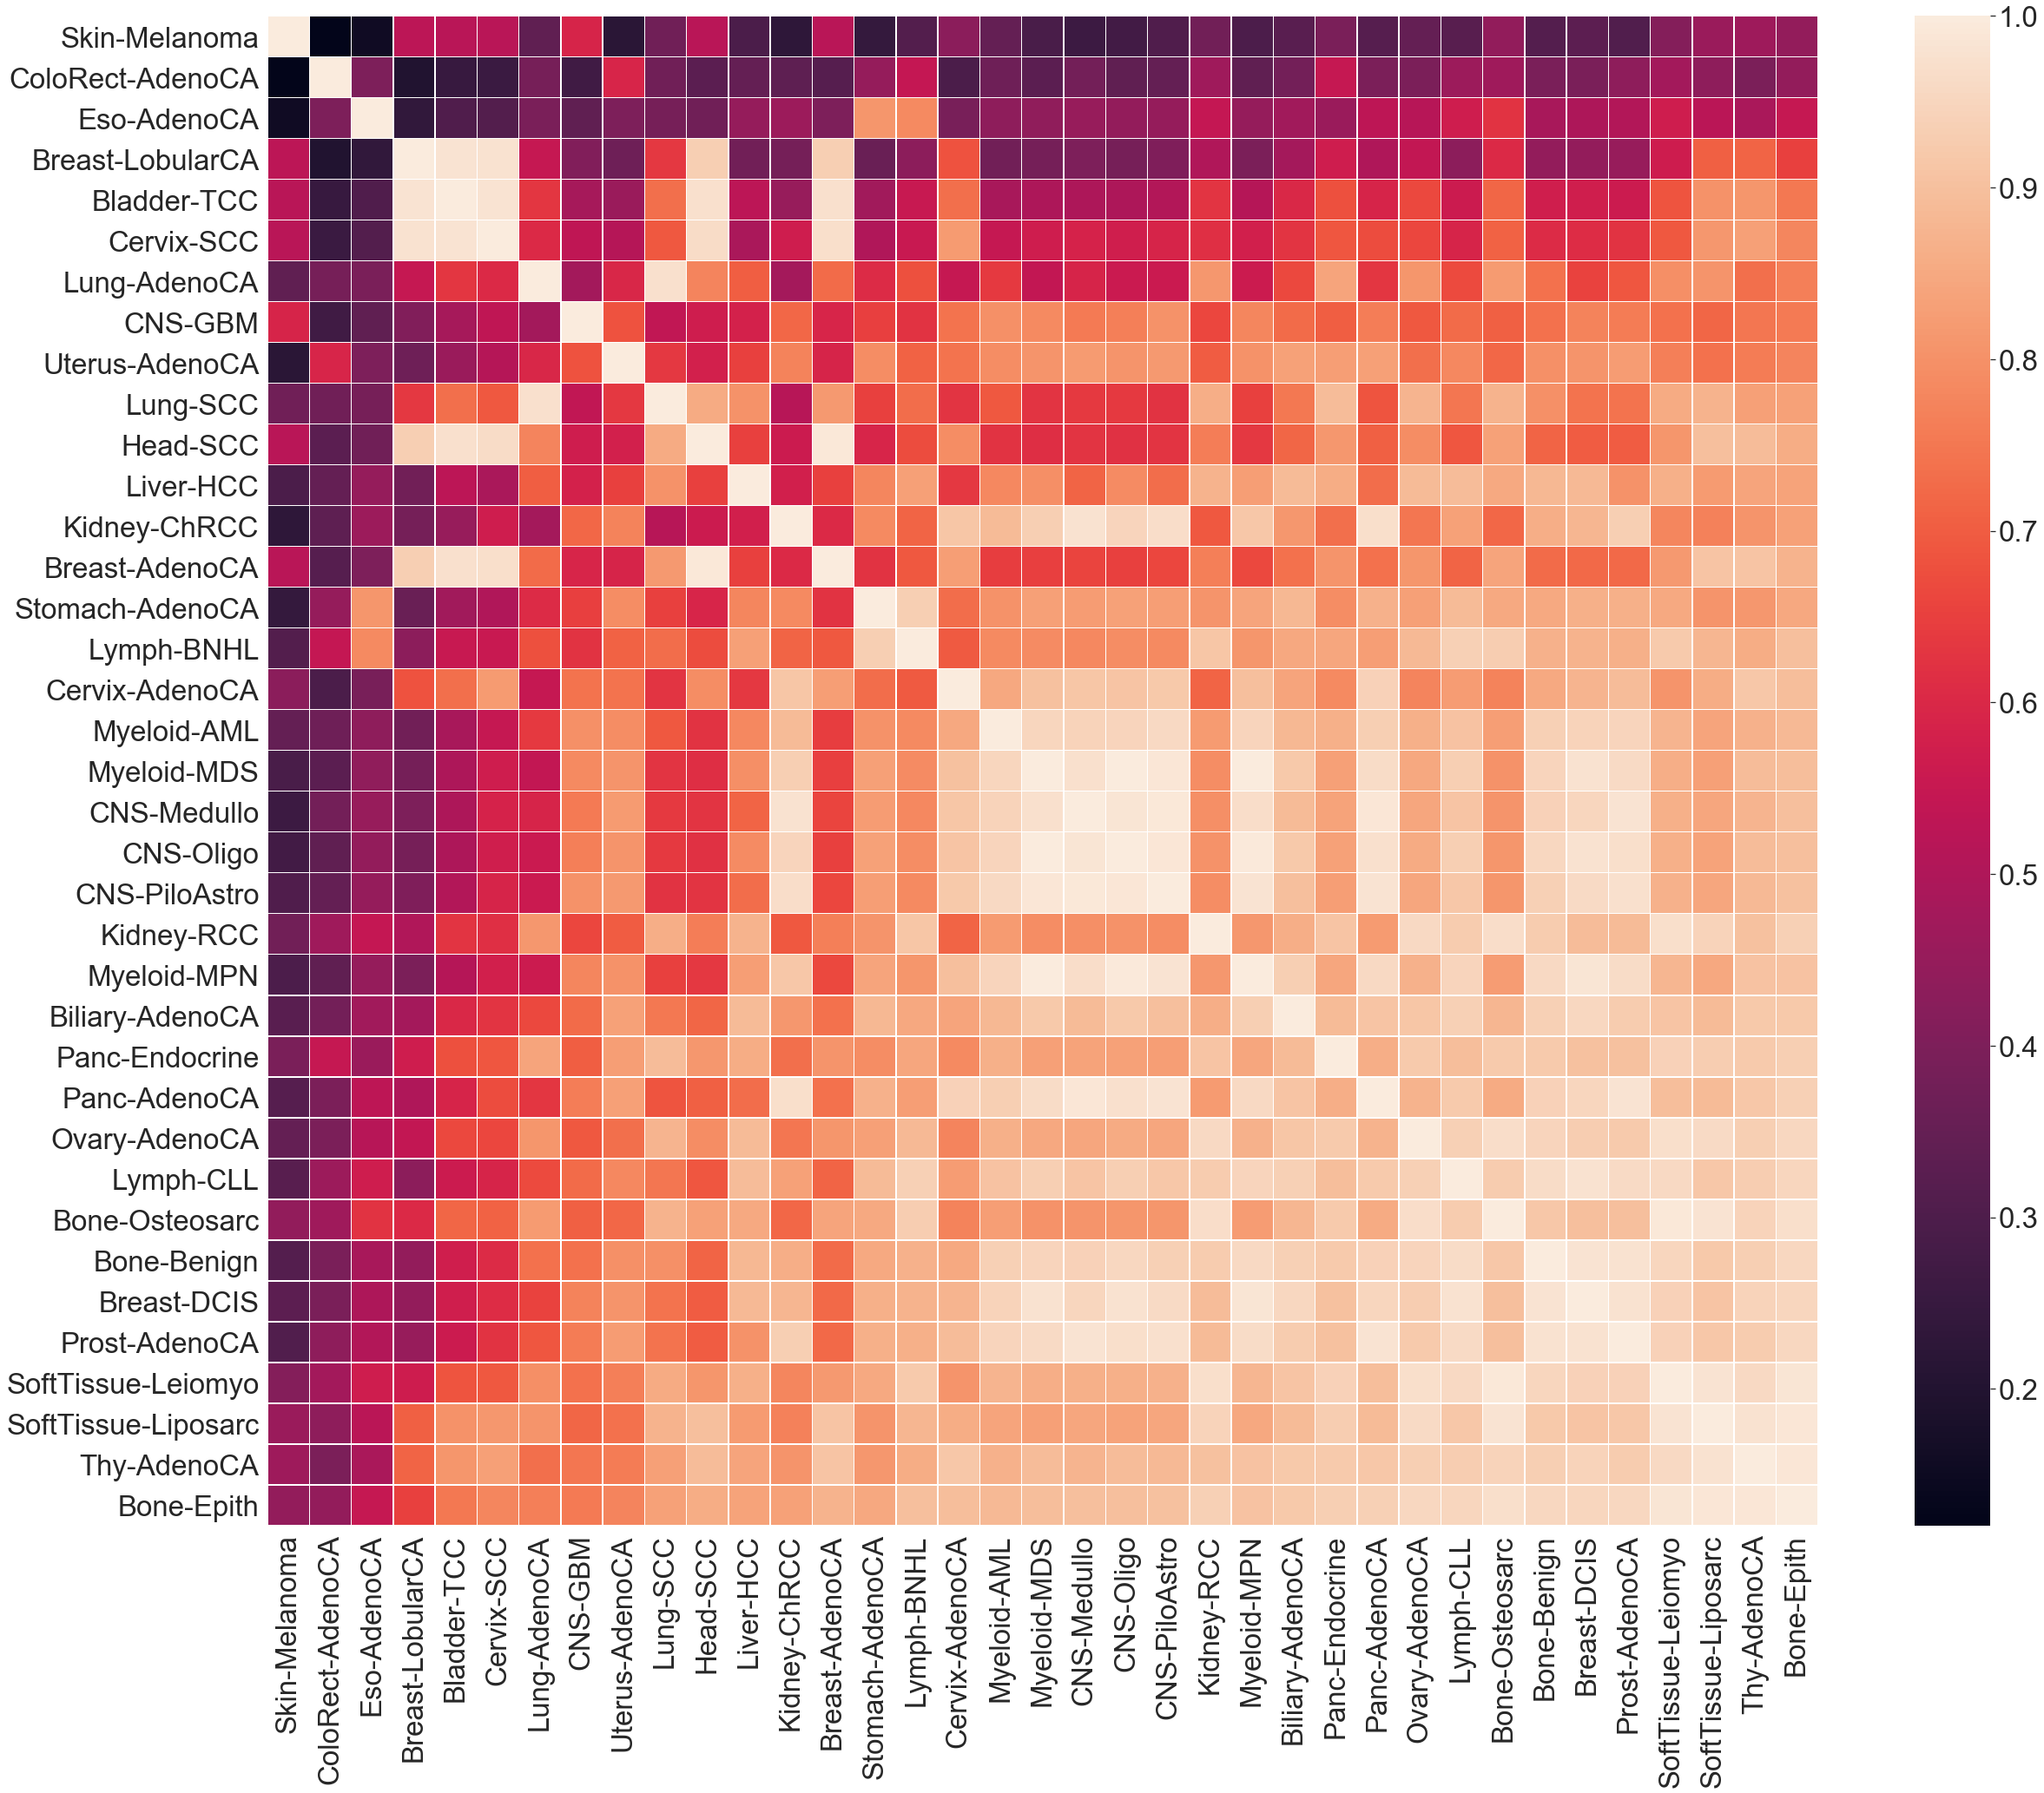
Visualization
Cosine Similarity of SBS Mutation PROFILE
Cosine similarity is metric used to compare the similarity of a multidimensional metric
Higher score indicates higher similarity between cancer types and more similar evolutionary trajectories

Slide 5
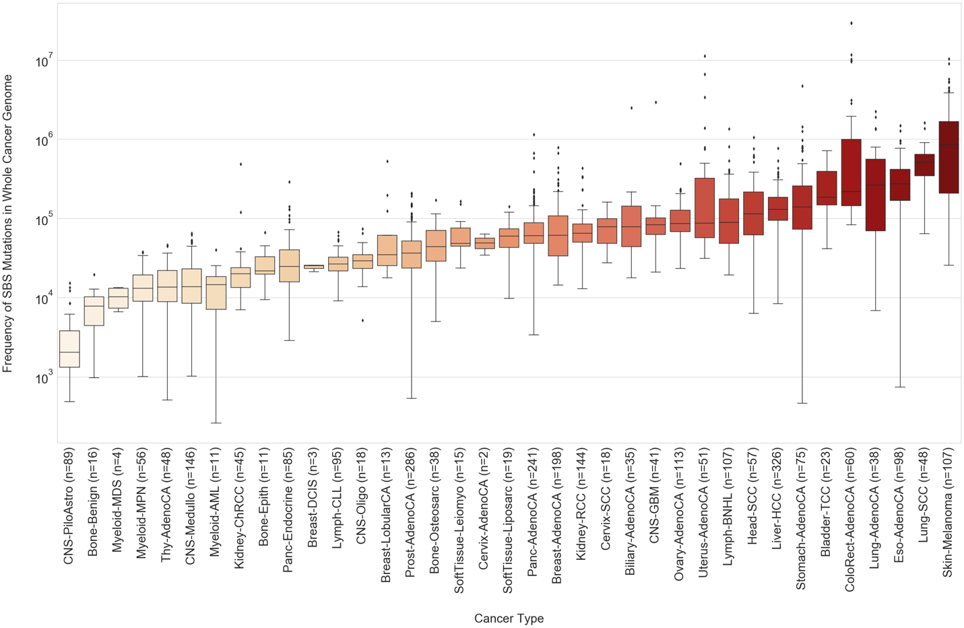
Visualization
SBS Mutation Burden in whole genome

Slide 6
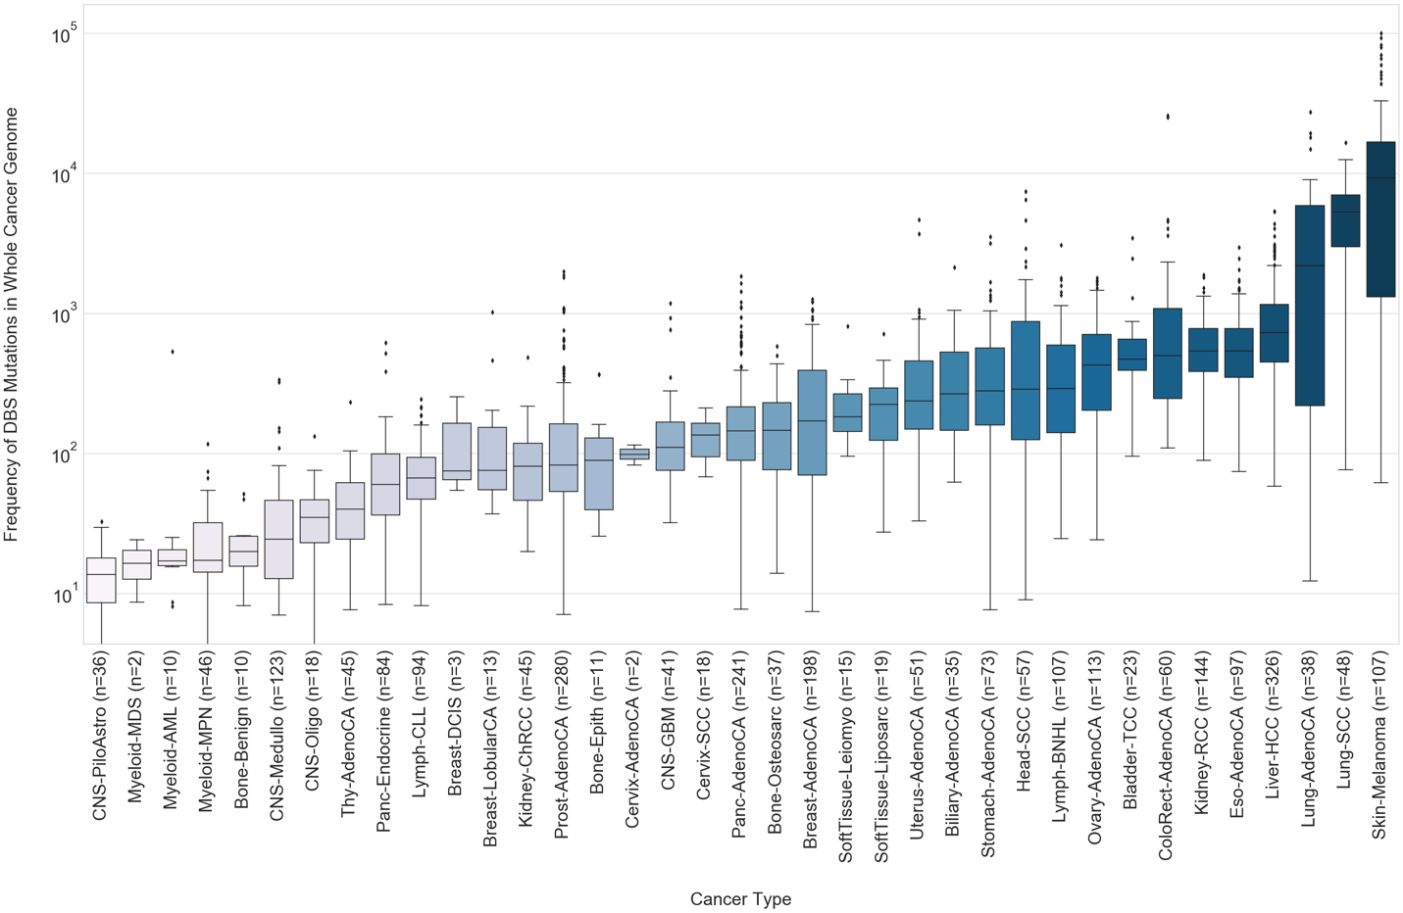
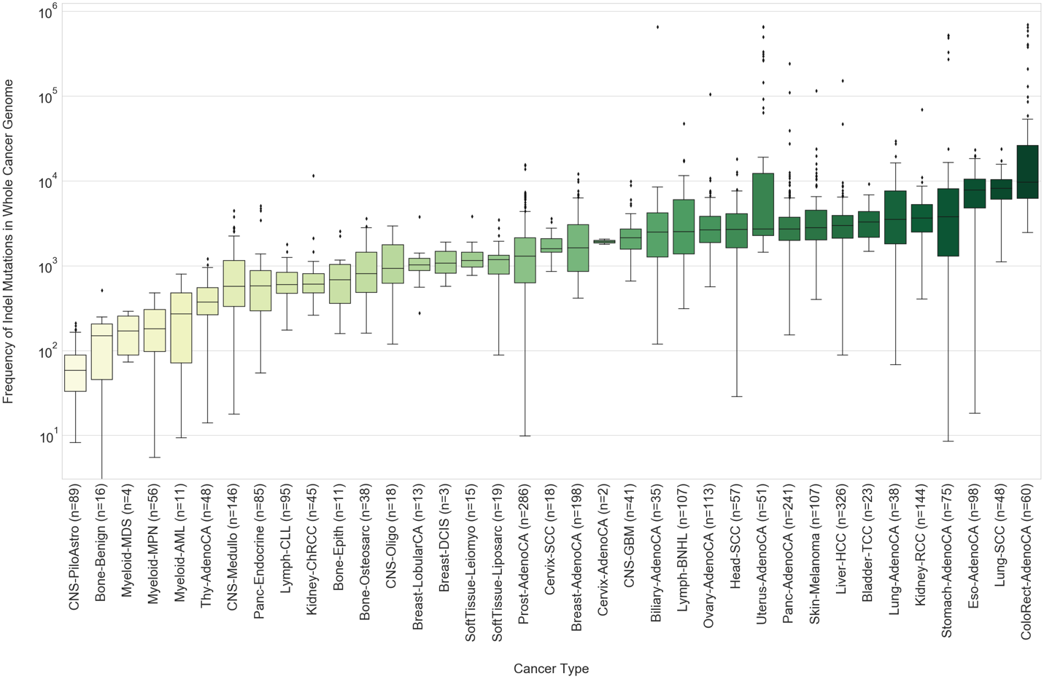
Visualization
DBS and Indel Mutation Burden in whole genome

Slide 7
Research Proposal
Research proposal
Genomic signatures have proven to be useful as methods for taxonomic classification
Alignment-free machine learning approaches can classify at the species level
Source: https://www.nature.com/articles/s41598-018-38157-3
Source: https://bmcgenomics.biomedcentral.com/articles/10.1186/s12864-019-5571-y
To what degree of accuracy and sensitivity can alignment-free machine learning approaches classify cancer whole genomic signatures?

Slide 8
Research Proposal
Use Case
Generated simulated cancer sequences as fasta files based on biologically representative frequencies of SBS, DBS and single- base indels
Benchmark the alignment-free machine learning approach for sensitivity between different cancer types
Benchmark alignment-free machine learning approaches for accuracy across successive iterations of mutation signature simulation on the same sequence

Slide 9
Somatic SiMu
Parallel Directed evolution simulation
Iteration 1
Iteration 2
Iteration 3
Cancer
Type Signatures

Slide 10
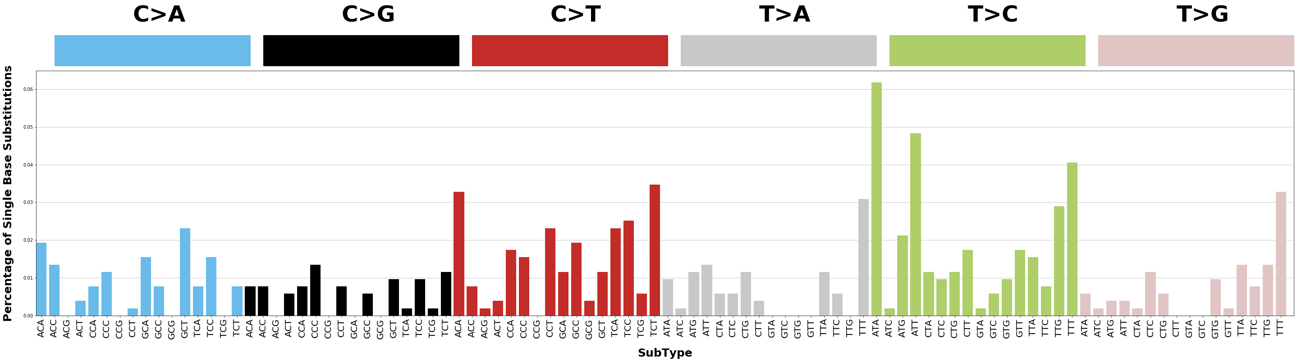
Somatic SiMu
Proof of concept: Liver-hcc
SomaticSiMu SBS Mutation Profile after 10 Generations of Simulation on Chromosome 22
COSMIC Mutation Profile for SBS5 and SBS12 active in Liver-HCC
Source: https://cancer.sanger.ac.uk/cosmic/signatures/

Slide 11
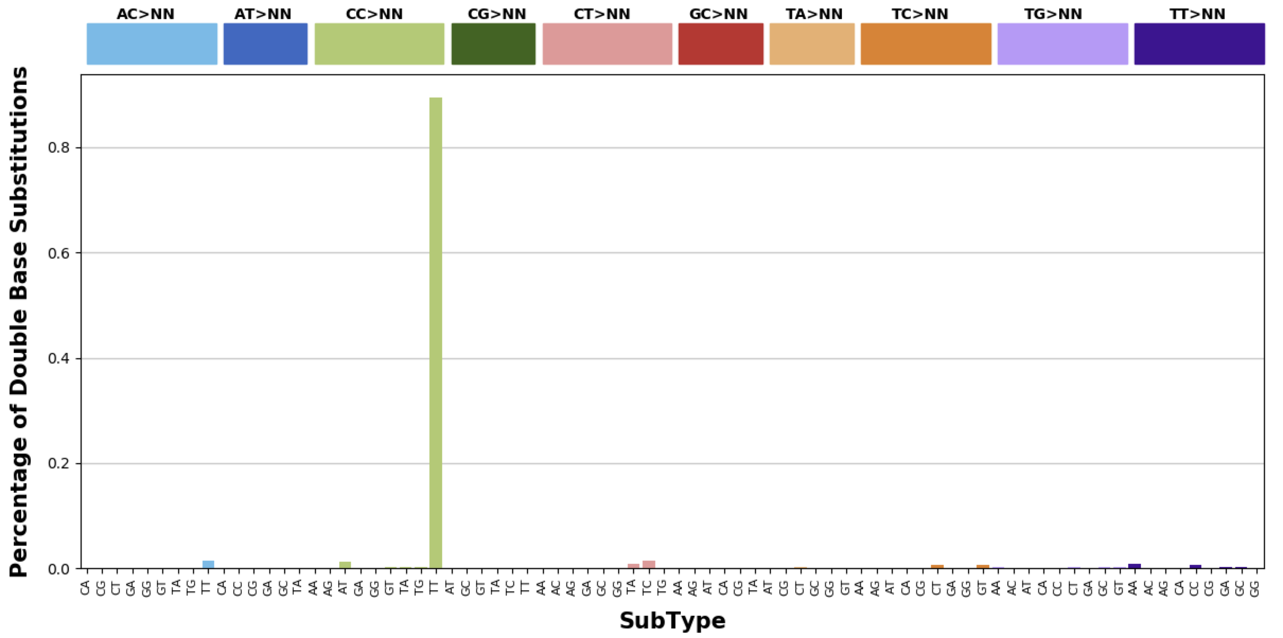
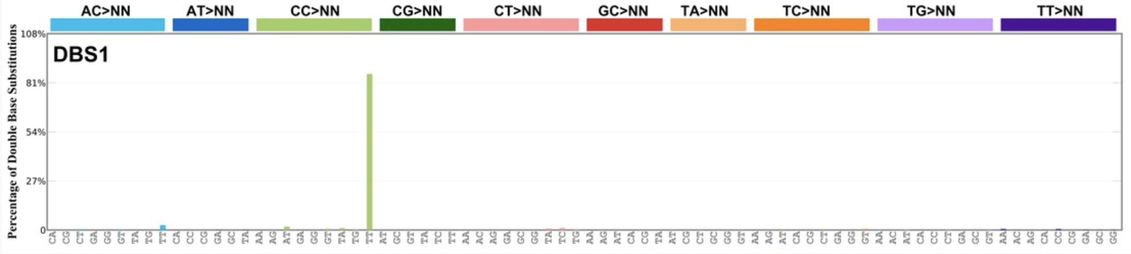
Somatic SiMu
Proof of concept: Skin-Melanoma
DBS Mutation Profile after 10 Generations of Simulation on Chromosome 22
COSMIC Mutation Profile for DBS1 active in Skin-Melanoma
Source: https://cancer.sanger.ac.uk/cosmic/signatures/

Slide 12
MLDSP-GUI Results
MLDSP Classification
Between Cancer Types and Within One Generation
Within One Cancer Type and Between Generations
Skin-Melanoma
Thyroid-AdenoCA
Skin-Melanoma
Thyroid-AdenoCA
Generation 1
Generation 1
Generation 1
Generation 1
Generation 2
Generation 2
Generation 2
Generation 2
Generation 3
Generation 3
Generation 3
Generation 3
Generation 4
Generation 4
Generation 4
Generation 4

Slide 13
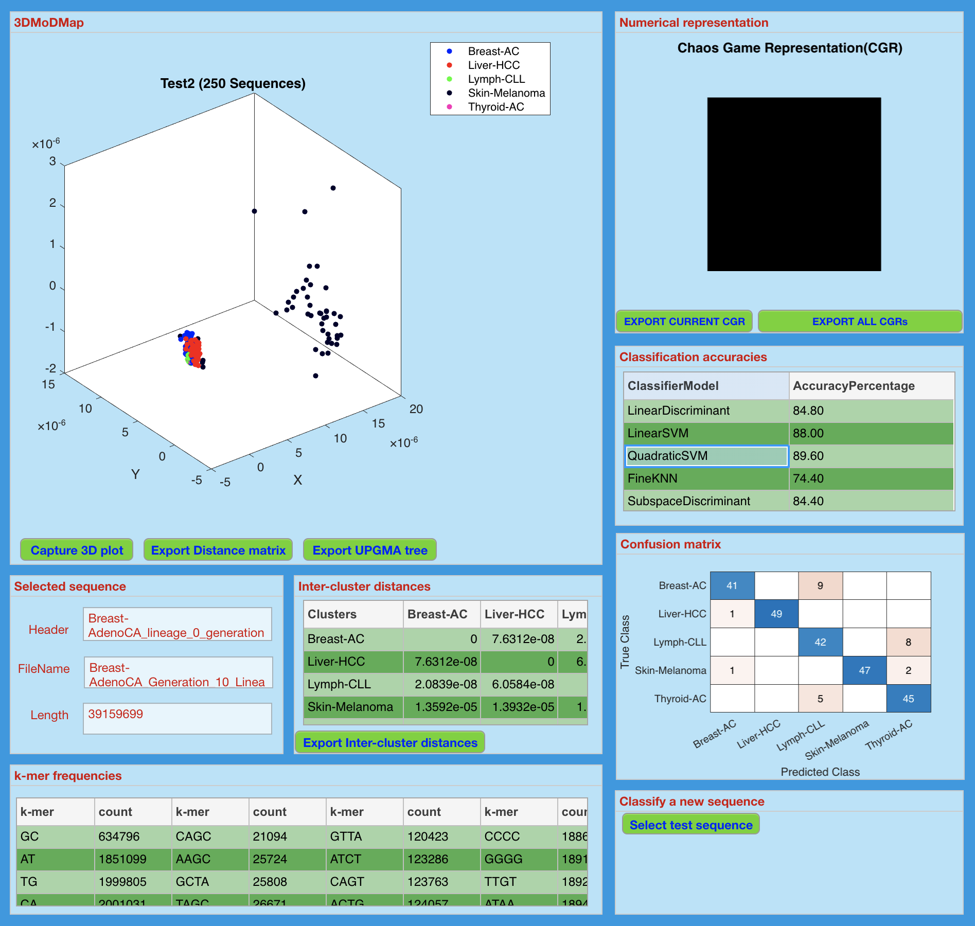
MLDSP-GUI Results
Classification of cancer types at Gen. 10
Parameters:
Input sequence: Chromosome 22
5 cancer types
50 sequences per cancer type
Num. Rep. : CGR
Distance Measure: Pearson
K value: 6

Slide 14
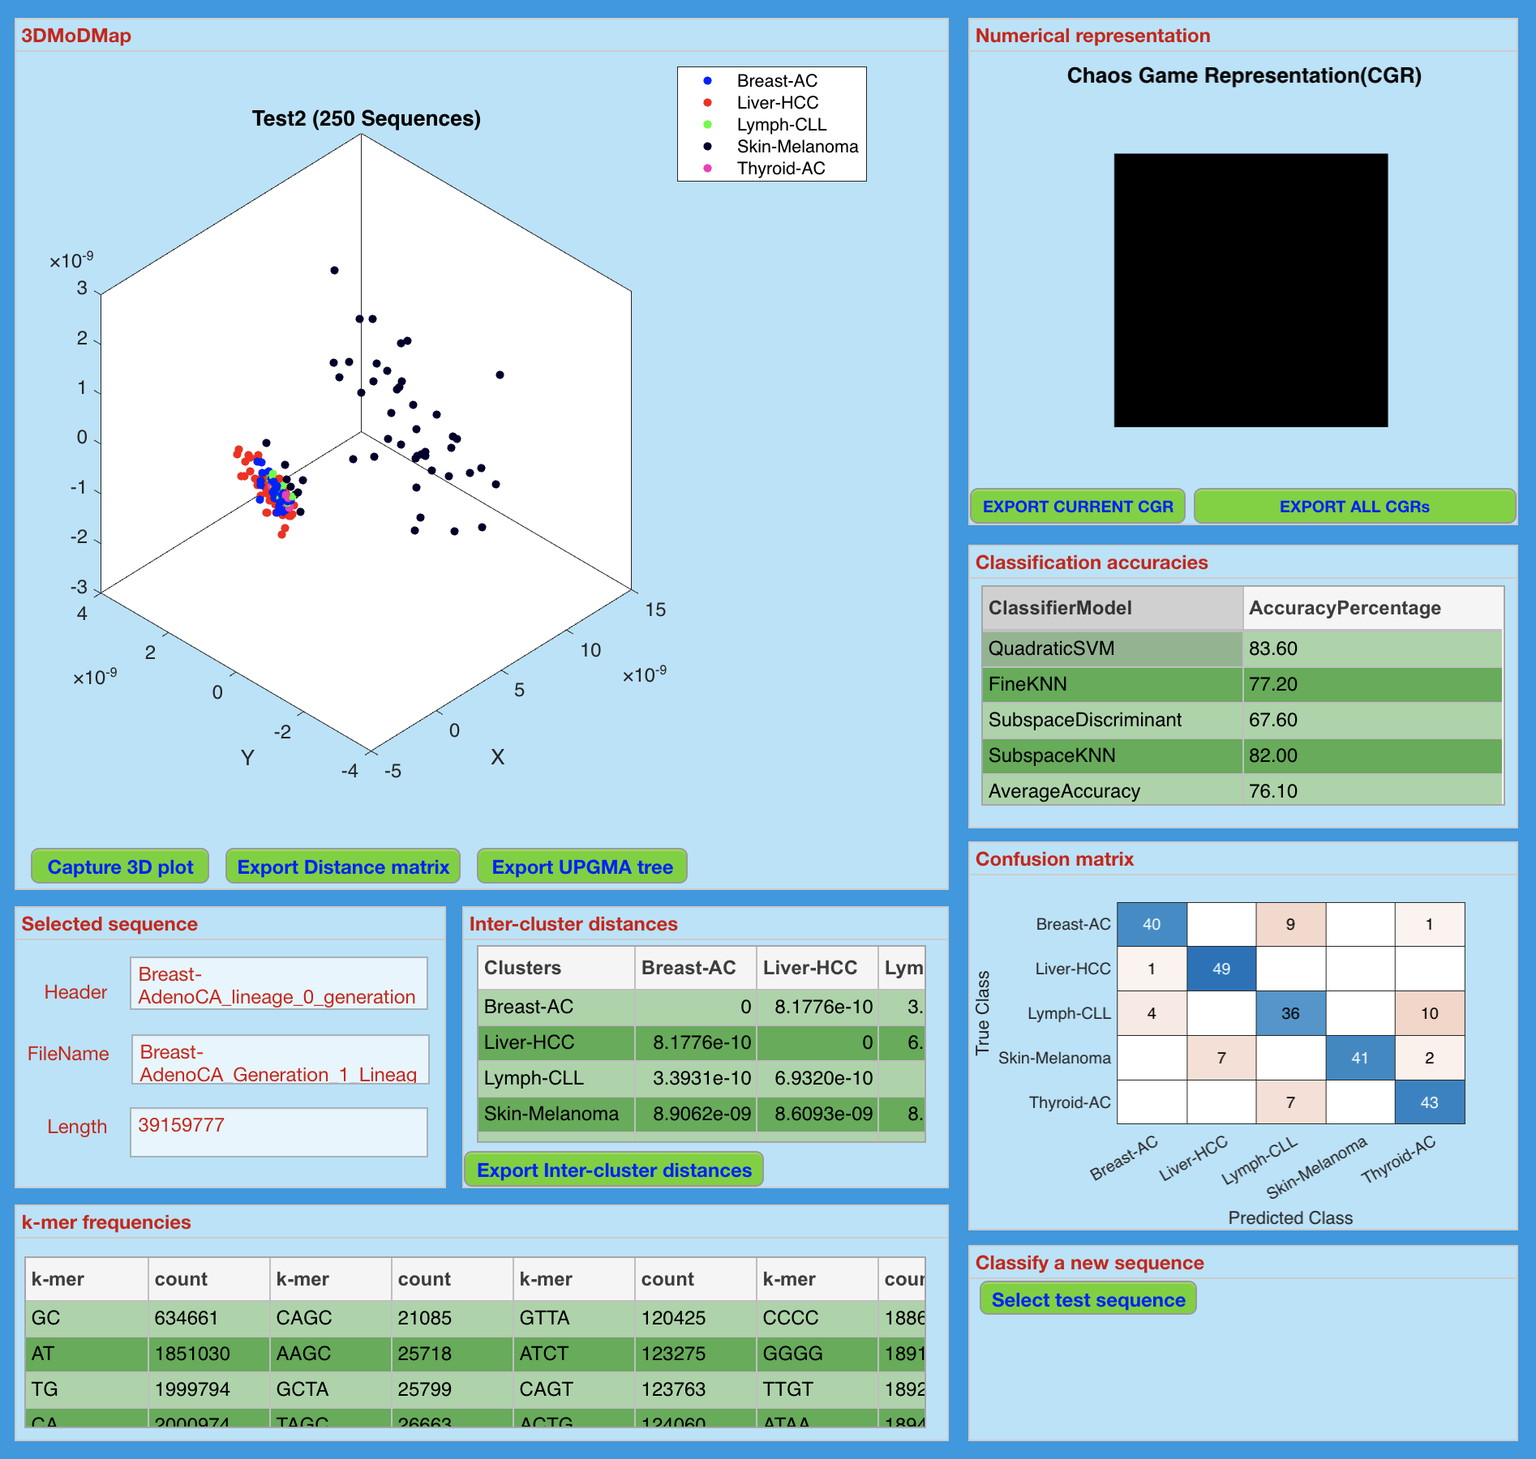
MLDSP-GUI Results
Classification of cancer types at Gen. 1
Parameters:
Input sequence: Chromosome 22
5 cancer types
50 sequences per cancer type
Num. Rep. : CGR
Distance Measure: Pearson
K value: 6

Slide 15
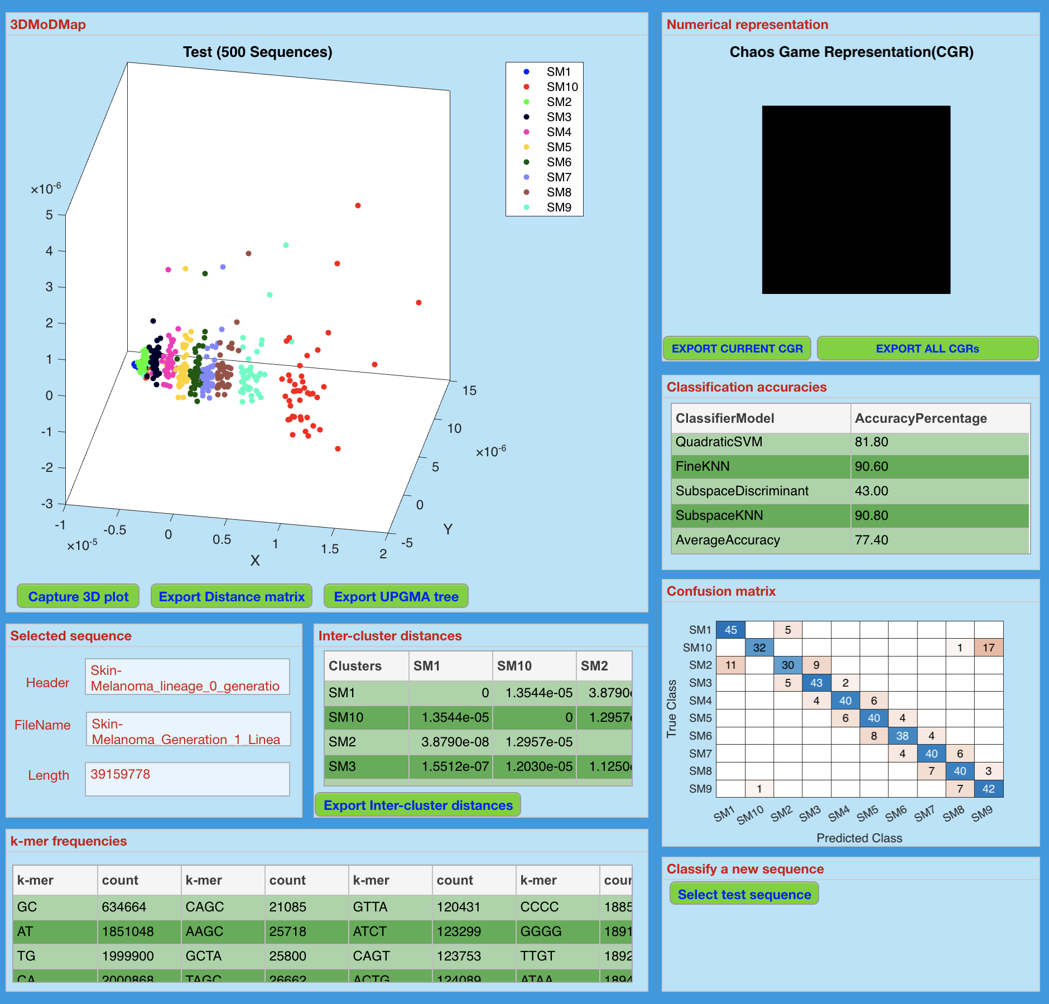
MLDSP-GUI Results
Classification of 10 iterative generations
Parameters:
Input sequence: Chromosome 22
Cancer type: Skin-Melanoma
50 sequences per generation
Num. Rep. : CGR
Distance Measure: Pearson
K value: 6

Slide 16

MLDSP-GUI Results
Classification of 10 iterative generations
Parameters:
Input sequence: Chromosome 22
Cancer type: Thyroid-AdenoCA
50 sequences per generation
Num. Rep. : CGR
Distance Measure: Pearson
K value: 6

